Slide 1
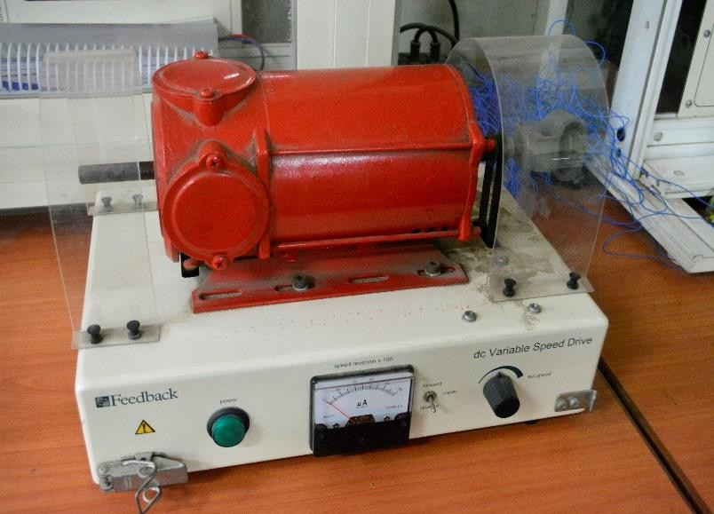
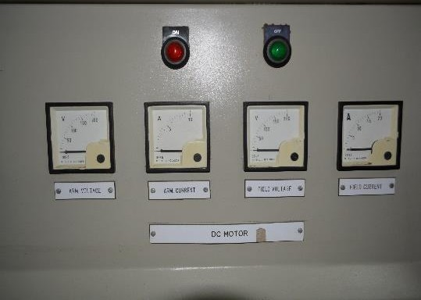
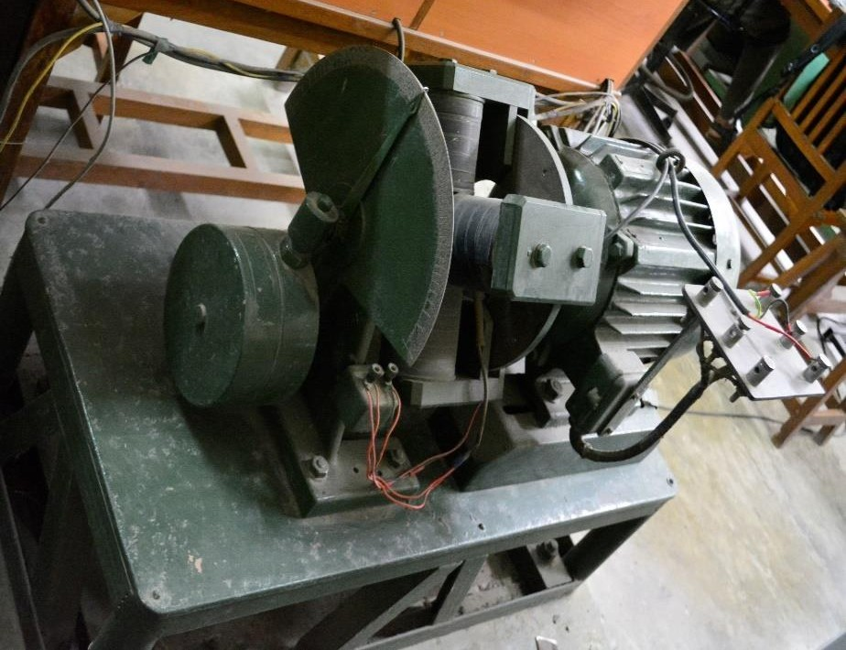
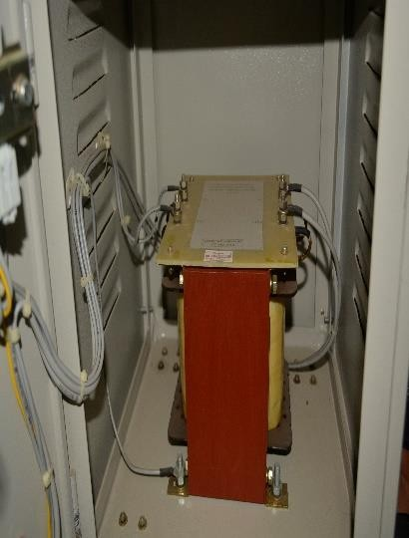
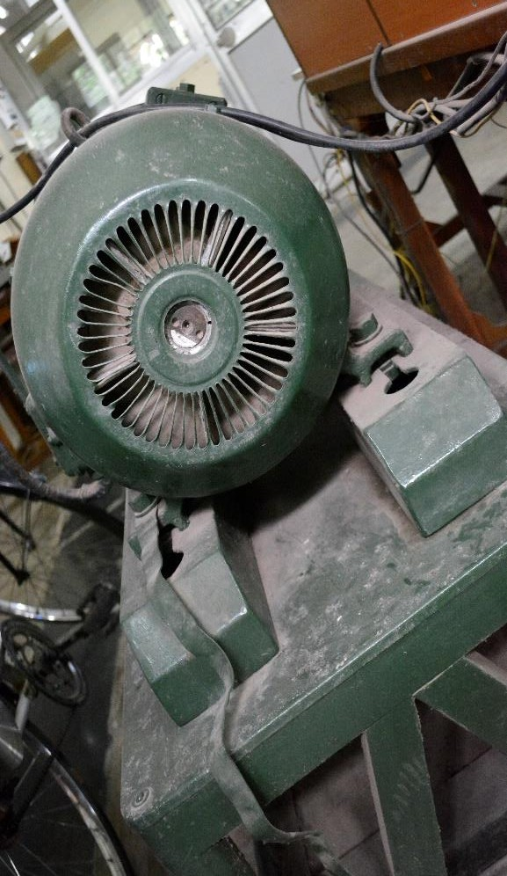
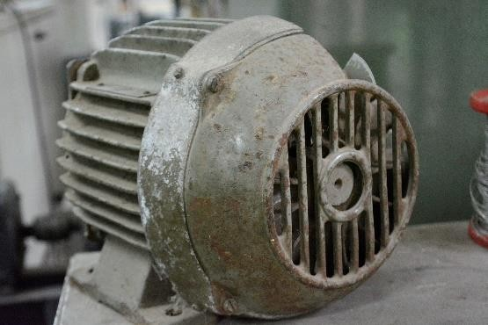

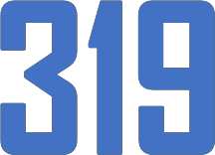


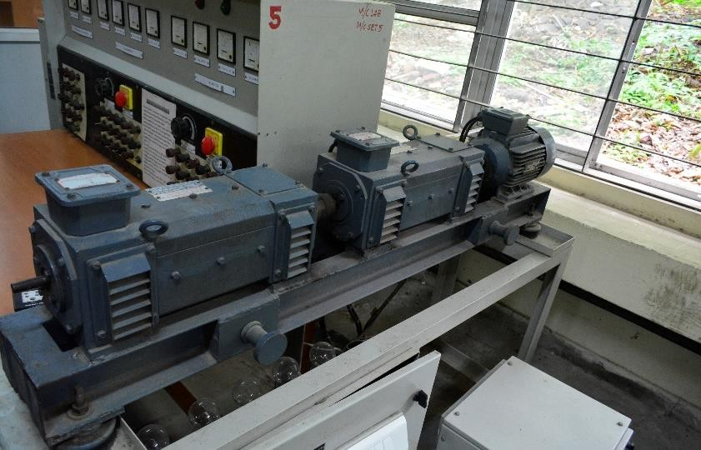
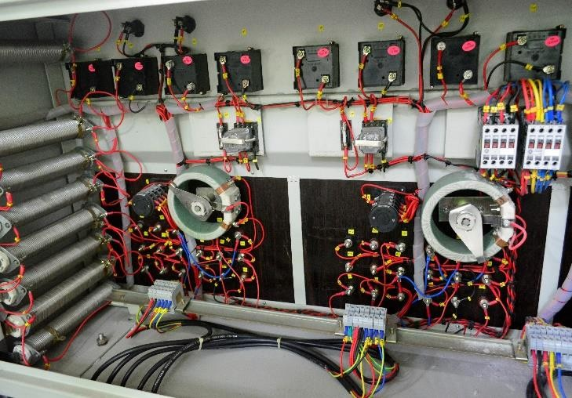
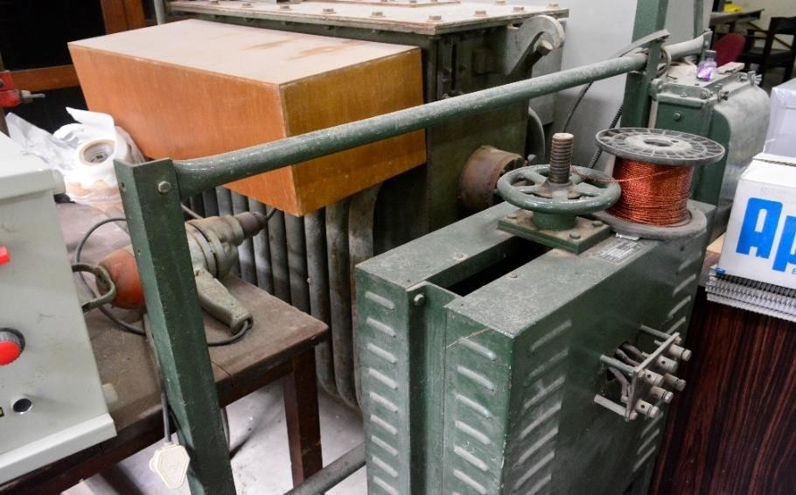
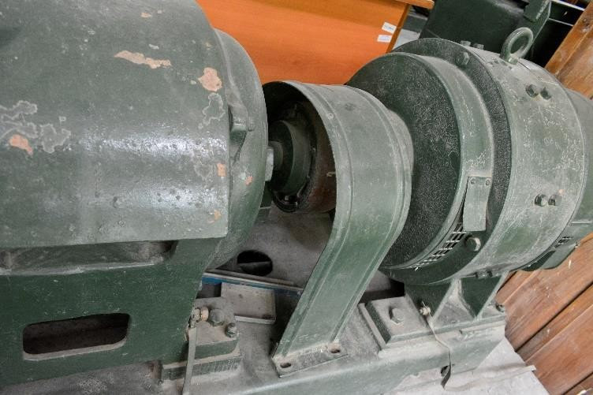


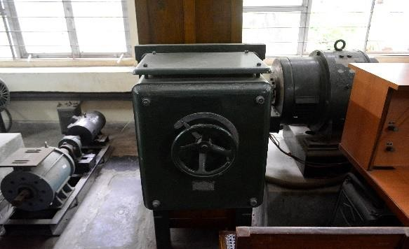
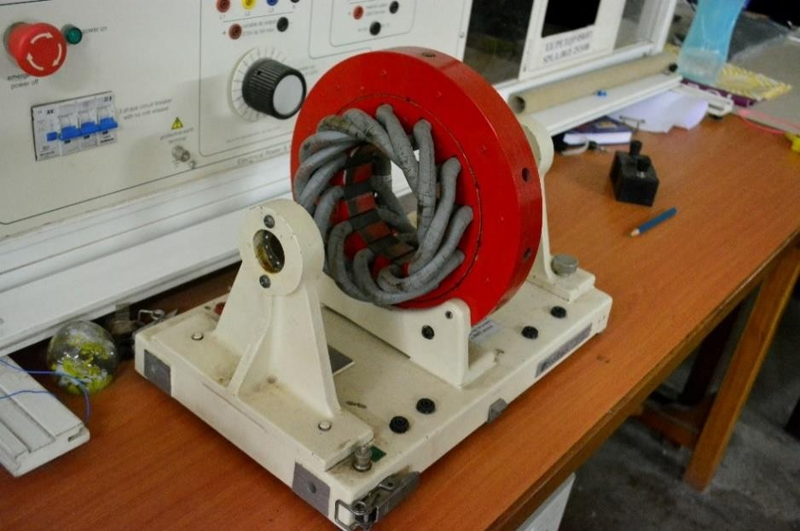
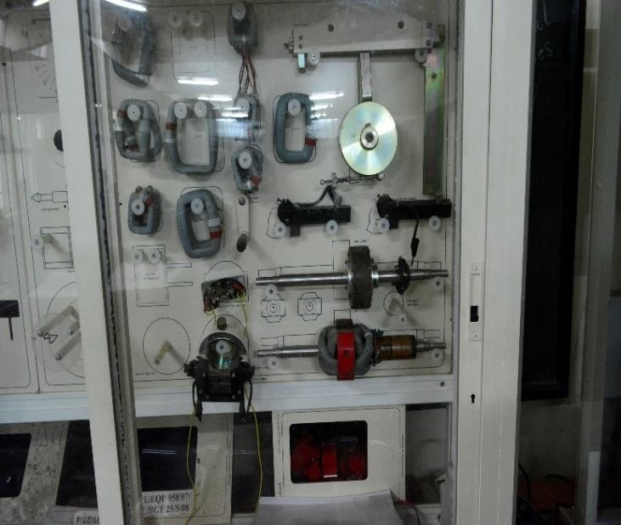
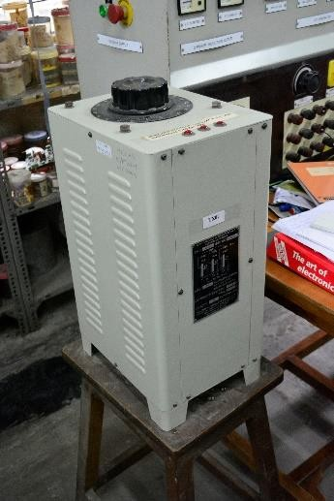
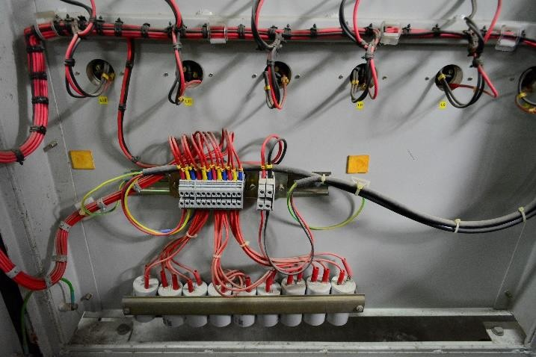
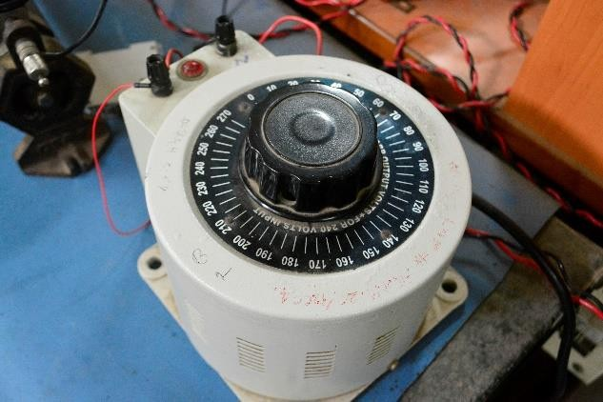


Slide 2
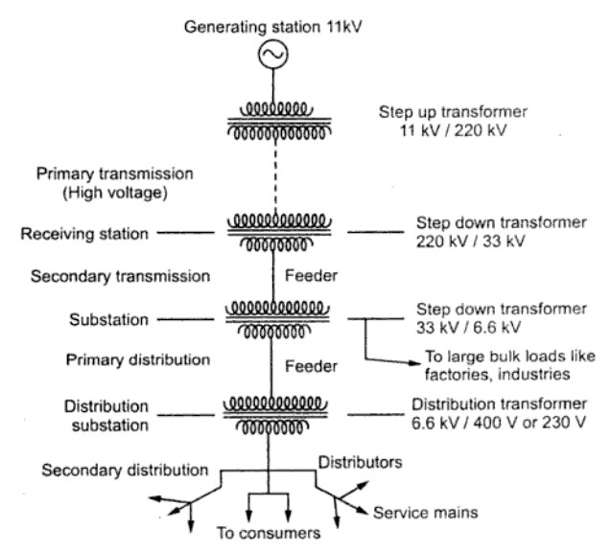
Introduction: Indian power system
Managed by POSCO (Power System Operation Corporation Ltd)
National Load Despatch Centre (NLDC) (based in New Delhi)
Five Regional Load Despatch Centres (Northern, Eastern, Western, Southern and North eastern)
All regions interconnected (synchronized)!!!
Three phase power in India:
415V (l-l) rms, 50Hz supply
Single phase supply in India:
240V (l-n) rms, 50Hz supply
Typical AC transmission and distribution system in India

Slide 3
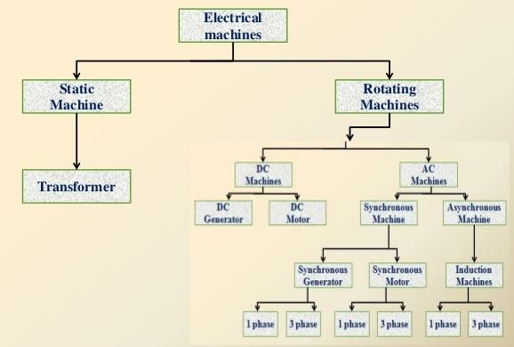
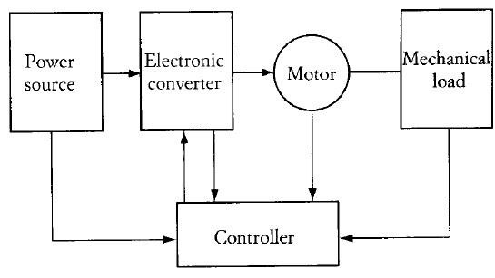
Classification of Electric machines
Schematic of an Electric drive
system
Machines, like any engineered system needs to be controlled: POWER ELECTRONICS

Slide 4
Some Applications
Power generation, transmission and distribution.
Pumping, fans, blowers, compressors in AC & refrigerators
Machine tools, hoists cranes, lifts.
Industry applications like in rolling, centrifuges, belt drives,
precise positioning and control systems etc.
Day-day applications:
windshield wipers and washers, to raise and lower windows, electric power steering in cars
printers, xerox machines, CD-DVD drivers, cameras, high-speed tape readers, XY recorders
Trending:
Renewables, MAGLEV, Electric vehicles

Slide 5
Special Electric machines
Brushless dc (BLDC) motors
Permanent magnet dc (PMDC) motors
Servomotors
Stepper motors
Switched reluctance motors (SRM)
Universal motor
Linear induction motor (LIM)
Linear synchronous motor (LSM)
Reluctance and hysteresis motors
Synchros
Variable reluctance (VR) motors
Printed circuit board (PCB) motors

Slide 6
Loss Classification in Electric machines
LOSSES IN A MACHINE
Constant Losses
Variable Losses
No Load (iron)
Losses
Mechanical
Losses
Copper Losses
Stray Load Losses
Hysteresis
Loss
Stator Cu
Rotor Cu Loss ∝ 𝐼²
Brush Contact
Eddy Current
Loss
2
(∝ I )
∝ I
Loss
Loss
Windage Loss (including ventilation) (∝ speed ² )
Friction Loss
Copper/conductor stray
load Loss
Iron/core stray load Loss
Brush Friction
(∝ speed ² )
Bearing Friction
(∝ speed )

Slide 7
Tasks
Derive the condition for maximum efficiency for a generator and a motor given that:
Total losses =
a + bI + cI ²
And electrical input or output ( motor or generator ) is =
Where A is 3 cosφ for a 3 phase machine
AVI
cosφ
1
for a 1 phase machine
for a dc machine
ANS: For both machines:
cI ² = a

Slide 8
Course Specifications
Course code: EN319 – Electrical Machines and Power
Electronics Lab
Number of credits: 03
Number of Experiments to be conducted : 5
Number of lab sessions : 10 (/2) of 3hr duration each
Venue : Electric machines lab EE department (ground floor)
Lab slot: Tuesday afternoon
➢ Timing: 1400h – 1700h

Slide 9
List of Experiments
Power measurement in balanced 3 phase circuits and power factor improvement
Open circuit and short circuit tests on single phase transformers
Characteristics of DC generators
Characteristics of Separately excited DC motor
Speed control of 3phase Induction motor

Slide 10
S NO | Roll No | Name | Batch
1 | 160110036 | SARAF PUSHKAR UMESH | B1
2 | 16D170002 | CHAUBAL SOUMIL KISHOR | B2
3 | 16D170003 | ANSARI MOHAMMAD RAZI MOHAMMAD REHAN | B3
4 | 16D170004 | ARYAN AGAL | B4
5 | 16D170006 | PRUTHVIRAJ SUNIL NETKE | B5
6 | 16D170007 | KUMARESH RAMESH | B6
7 | 16D170008 | TRISHANT ROY | B3
8 | 16D170009 | DESHPANDE VARAD PRAMOD | B8
9 | 16D170010 | MOHITE INDRAJEET NAGESH | B9
10 | 16D170011 | MENON GOVIND RAJESH | B1
11 | 16D170012 | AMLEKAR SHRVAN SHRIKRISHNA | B2
12 | 16D170013 | KSHIRSAGAR PRANAV BAPU | B3
13 | 16D170014 | VYANKTESH ISHWARCHANDRA NAGRE | B4
14 | 16D170015 | CHITRANGNA BHATT | B5
15 | 16D170016 | ANKIT S BATTISE | B6
16 | 16D170017 | RAHUL KUMAR MEENA | B8
17 | 16D170018 | PREMANSHU KUMAR SINGH | B7
18 | 16D170019 | ADITI MAHAJAN | B9
19 | 16D170020 | AAYUSH GARG | B1
20 | 16D170021 | SOURABH SURAGE | B2
21 | 16D170022 | MANOJ VISHWAKARMA | B7
22 | 16D170023 | ABHISHEK SISODIYA | B4
23 | 16D170025 | ANSHUL MAHOR | B5
24 | 16D170026 | SATYAPRAJNA SARTHAK SAHOO | B7
25 | 16D170027 | PRABHAT RANJAN | B7
26 | 16D170029 | KONDETI ISAIAH BENEDICT | B8
27 | 16D170031 | ANANT TARANIYA | B9
28 | 15D170028 | SOUMYA PRAMANIK | B6
Lab batches list
SET 1: B1, B3, B5, B7, B9
SET 2: B2, B4, B6, B8

Slide 11
EN 319 Course Schedule '18
Date | Schedule
17 / 7 / 2018 | Introduction
24 / 7 / 2018 | Experiment 1 (Set 1)
31 / 7 / 2018 | Experiment 1 (Set 2)
07 / 8 / 2018 | MCQ Exam
14 / 8 / 2018 | Experiment 2 (Set 1)
21 / 8 / 2018 | Experiment 2 (Set 2)
28 / 8 / 2018 | Experiment 3 (Set 1)
04 / 9 / 2018 | Experiment 3 (Set 2)
18 / 9 / 2018 | Experiment 4 (Set 1)
25 / 9 / 2018 | Experiment 4 (Set 2)
09/ 10 / 2018 | Experiment 5 (Set 1)
16/ 10 / 2018 | Experiment 5 (Set 2)
23 / 10 / 2018 | Finalisation of marks (50%)
Submission at Power Engineering Lab

Slide 12
Course grading
Grading Scheme:
> Experiment conduction, viva, report and MCQs : 40%+10%
(Averaged for 5 experiments)
> Examination (individual basis) 50%
Each lab session is for 50 marks:
experiment conduction: 10 marks
viva: 10 marks
report: 30 marks
Exam in 2 sessions (4 batches)
For this year:
Date | Schedule
30 / 10 / 2018 | Day 1 ( Batches: A1 & A2 )
31 / 10 / 2018 | Day 2 ( Batches: B1 & B2 )
Exam format: viva, experiment conduction and report

Slide 13
S NO | Roll No | Name | Batch
1 | 160110036 | SARAF PUSHKAR UMESH | A1
2 | 16D170002 | CHAUBAL SOUMIL KISHOR | A2
3 | 16D170003 | ANSARI MOHAMMAD RAZI MOHAMMAD REHAN | B1
4 | 16D170004 | ARYAN AGAL | A1
5 | 16D170006 | PRUTHVIRAJ SUNIL NETKE | B1
6 | 16D170007 | KUMARESH RAMESH | A2
7 | 16D170008 | TRISHANT ROY | B2
8 | 16D170009 | DESHPANDE VARAD PRAMOD | B1
9 | 16D170010 | MOHITE INDRAJEET NAGESH | A2
10 | 16D170011 | MENON GOVIND RAJESH | B2
11 | 16D170012 | AMLEKAR SHRVAN SHRIKRISHNA | A1
12 | 16D170013 | KSHIRSAGAR PRANAV BAPU | B2
13 | 16D170014 | VYANKTESH ISHWARCHANDRA NAGRE | B1
14 | 16D170015 | CHITRANGNA BHATT | A2
15 | 16D170016 | ANKIT S BATTISE | B2
16 | 16D170017 | RAHUL KUMAR MEENA | B1
17 | 16D170018 | PREMANSHU KUMAR SINGH | A1
18 | 16D170019 | ADITI MAHAJAN | B1
19 | 16D170020 | AAYUSH GARG | A2
20 | 16D170021 | SOURABH SURAGE | A1
21 | 16D170022 | MANOJ VISHWAKARMA | B2
22 | 16D170023 | ABHISHEK SISODIYA | B2
23 | 16D170025 | ANSHUL MAHOR | A2
24 | 16D170026 | SATYAPRAJNA SARTHAK SAHOO | A1
25 | 16D170027 | PRABHAT RANJAN | B1
26 | 16D170029 | KONDETI ISAIAH BENEDICT | A2
27 | 16D170031 | ANANT TARANIYA | A1
28 | 15D170028 | SOUMYA PRAMANIK | B2
Batches | Exam Day | No. of students
A1 | DAY 1 | 7
A2 | DAY 1 | 7
B1 | DAY 2 | 7
B2 | DAY 2 | 7
TIMINGS 1:55 TO 3:55 AND 4:00 TO 6:00 PM
 | on BOTH DAYS
Lab Exam batches list

Slide 14
Rules and regulations
All Students are to:
Read the manuals, material provided and come prepared for the viva of the experiment to be conducted.
Attend all lab sessions and conduct the experiments as per the instructions
provided by the TAs
Submit completed reports as per prescribed format of the experiment conducted in the previous lab session at the beginning of the next session
Ensure safety during the conduction of experiments (No Loose hangings items)
NOTE:
Students are expected to be inside the lab STRICTLY 5 minutes prior to the starting of the lab sessions. (Penalty of 1 mark/minute till 1405h!!)
2. Wearing of shoes is COMPULSORY for all the lab sessions.
NO USE OF MOBILE in the lab (penalty)
Keep mobiles in SILENT MODE when leaving outside in your bag .

Slide 15
Plan for each lab session..
Viva 40 min
Presentation 20 min
Simulation 10/15 min
Experiment 1.5 h
(demo in between) 10/15 min
In case of issues : inform apriori by mail:
174176011@iitb.ac.in or 8979446257

Slide 16
Lab reports
Name plate details (http://electrical-engineering-portal.com/19-essential-information-you-can-find-on-motor-nameplate)
Procedure: In your own words, explain what has to be done, not
instructions as given in the manual ! ( attention to proper tense )
Be precise and clear in your statements: voltage: rated? Armature/ field? Dc/Ac?
Power: real/ reactive /apparent????
Take all meter readings….?? Which??
Conclusions: plot/eff or regulation was obtained…
But mention what you observed?....comment on the slope of the plot, or
the value of the efficiency you obtained…
Error analysis

Slide 17
Regarding lab report grading
Item | Marks
Aim + Name plate details +apparatus | 1+2+1
Procedure | 4
Circuit diagrams (only) | 3
Tabulated readings | 4
Sample calculations/ graphs | 2+3
Observations/ conclusions | 3
Answers to questions in manual | 7
1 report / batch
Total of 30 marks / experiment
Submission at beginning of next lab session ( if not, marks awarded=0 ! )
To be hand written (using pen, diagrams/graphs in pencil) only
Only booklet submissions accepted
No scope for resubmission
Sample report provided for guideline
Graphs to be plotted by hand : no online work

Slide 18
TA list DESE (autumn sem 2018)
PhD students:
Ravindranadh V (174176011@iitb.ac.in)
Mtech students:
Akash Harsh (173170007@iitb.ac.in)
Sumit Shirbhate (173170014@iitb.ac.in)
Himalaya Bhavsar (173170020@iitb.ac.in)
DD students:
Shivasubramanian (14d170030@iitb.ac.in)
Akhil Sai (14d170028@iitb.ac.in)

Slide 19
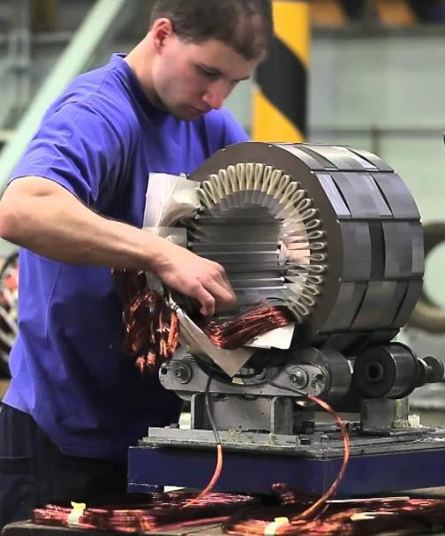

What to expect
A birds eyeview (sneak peek) into the world of electric machines
A very vast and deep field ( few expert researchers)
Experiments : hands on experience on some commonly used
electric machines
Some basics of machine working principles
Demos
Learning to write proper technical reports!
Learning punctuality and safety practices!

Slide 20
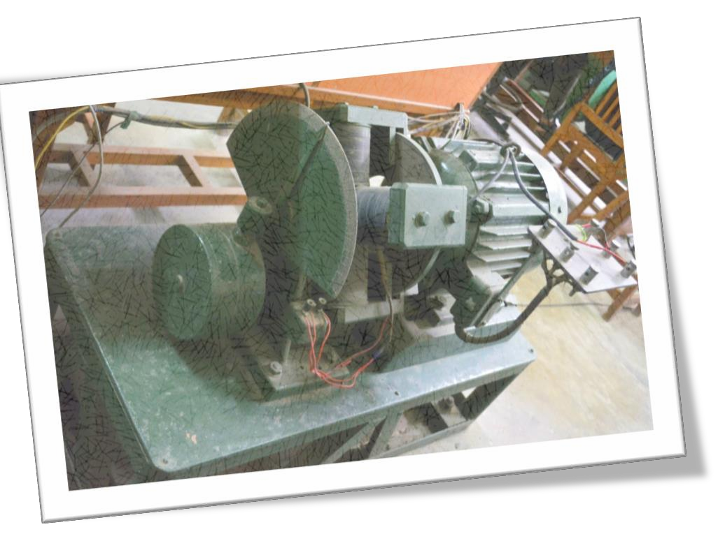
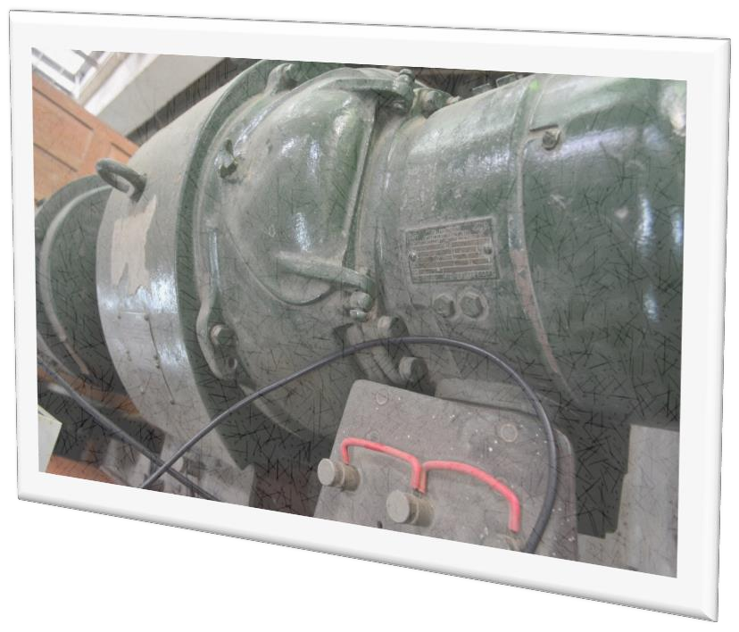
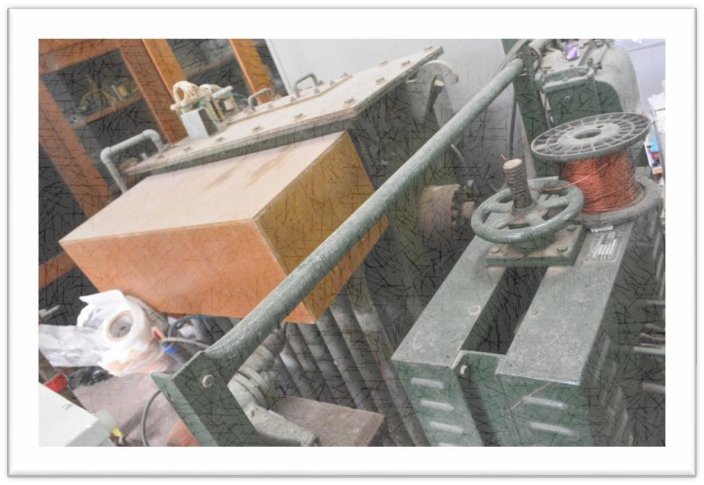

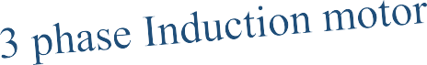
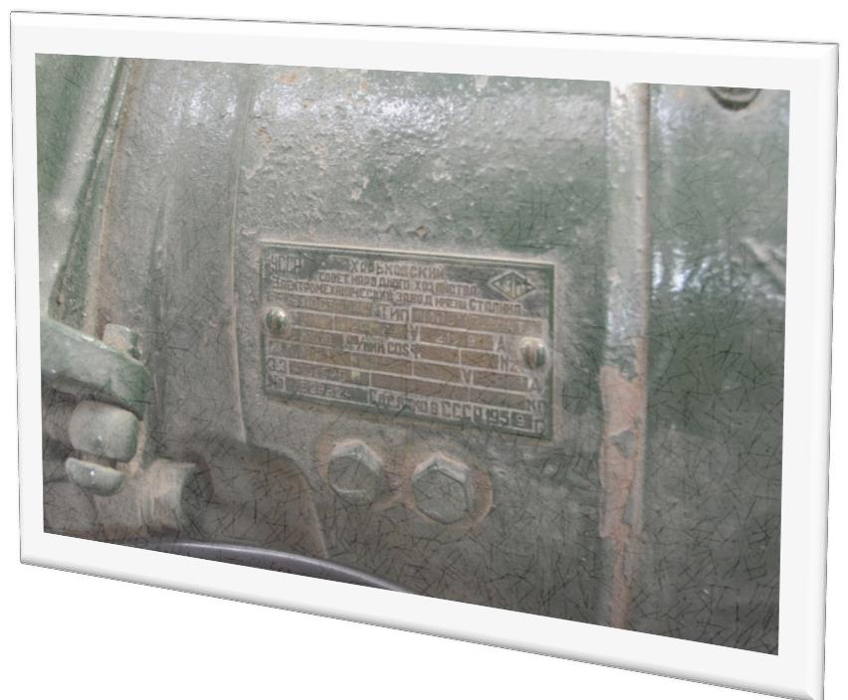
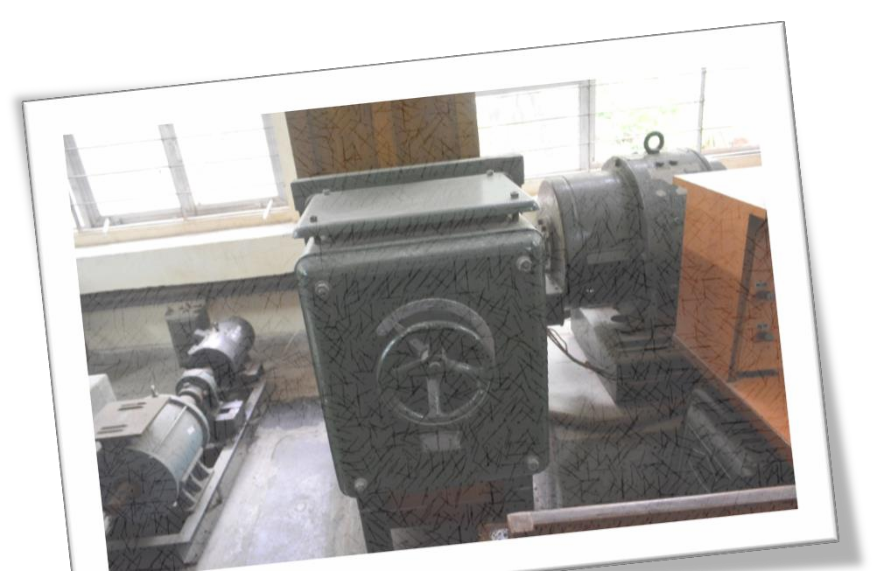

IITB: From the pages of history..
Transformer
Starter

Slide 21
Slides prepared by :Ravindranadh V 174176011@iitb.ac.in

